Slide 1
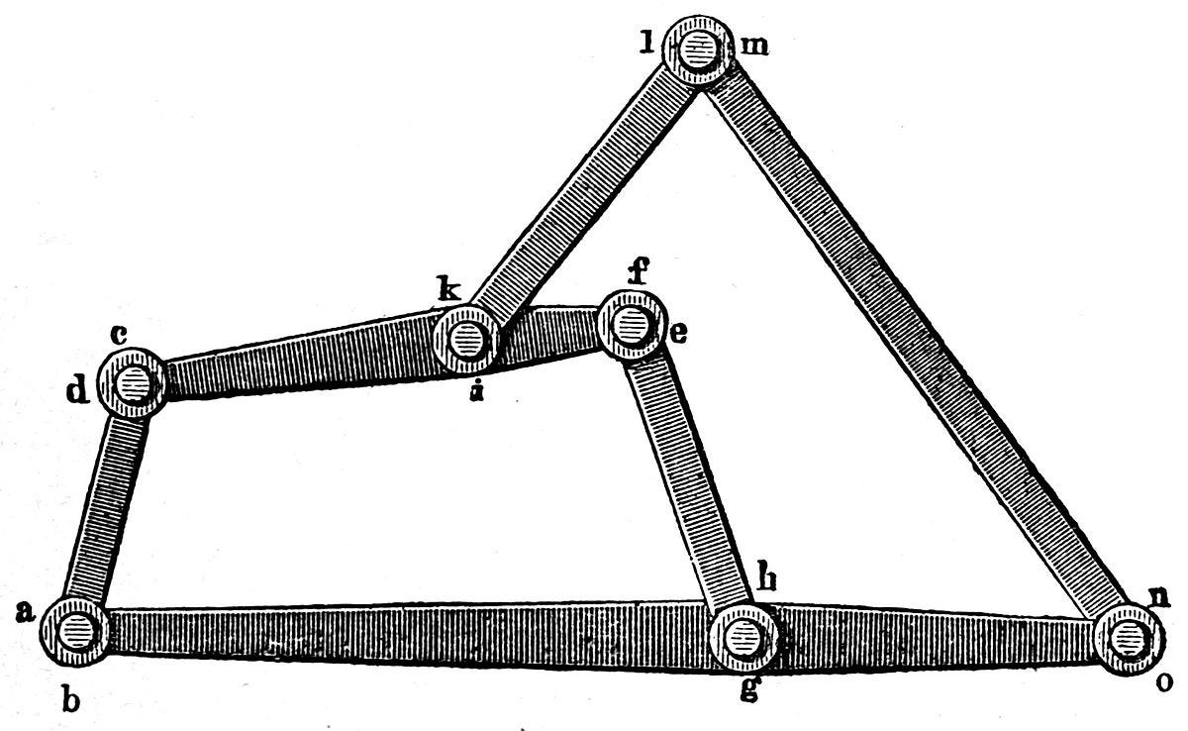
Kinematics and Dynamics
Day 03 | MP 3010
Linkage Mechanisms
Velocity Vector Diagram
Acceleration Vector Diagram

Slide 2
Linkage Mechanisms
Section 1

Slide 3
Linkages
Link
A rigid body having two or more pairing elements which connect to other bodies for the purpose of transmitting force or motion.
Kinematic link
A resistant body in a machine which moves relative to another resistant body.

Slide 4
Types of Links
Joint / Kinematic pair
Provides the connection between links. Two links of a machine when in contact with each other, are said to form a pair.
Kinematic pairs are classified using various aspects such as
• motion between links
• contact area between links
• closure of links

Slide 5
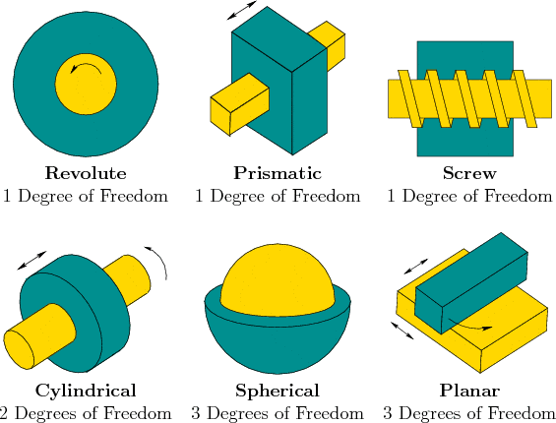
Kinematic Pairs

Slide 6
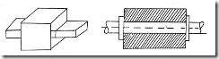
Lower Pairs
If the joint by which two members are connected has surface contact, the pair is known as lower pair. Eg. pin joints, shaft rotating in bush, slider in slider crank mechanism.
Fig.1 Lower pairs

Slide 7
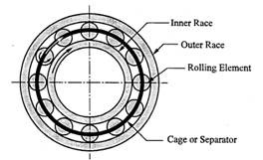
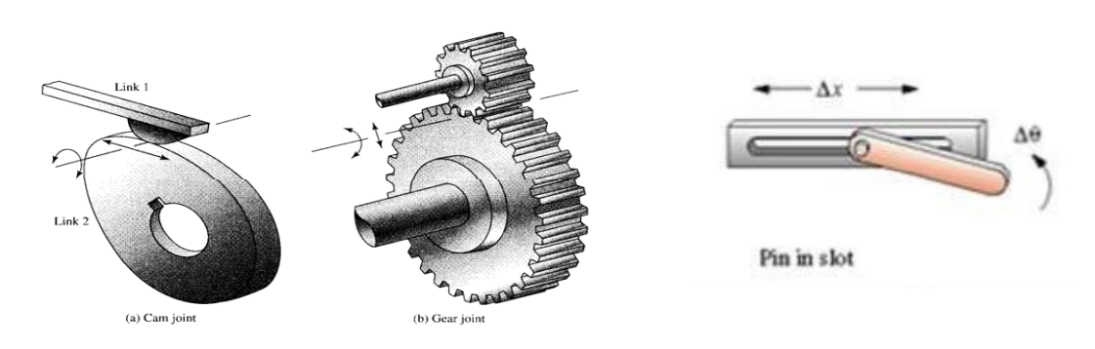
Higher Pairs
If the contact between the pairing elements takes place at a point or along a line, such as in a ball bearing or between two gear teeth in contact, it is known as a higher pair.

Slide 8
Kinematic chain is a combination of links and pairs without a fixed link.
Mechanism is a kinematic chain in which at least one link is a fixed link.
Degree of Freedom is number of independent movements a rigid body has in a plane / space.

Slide 9
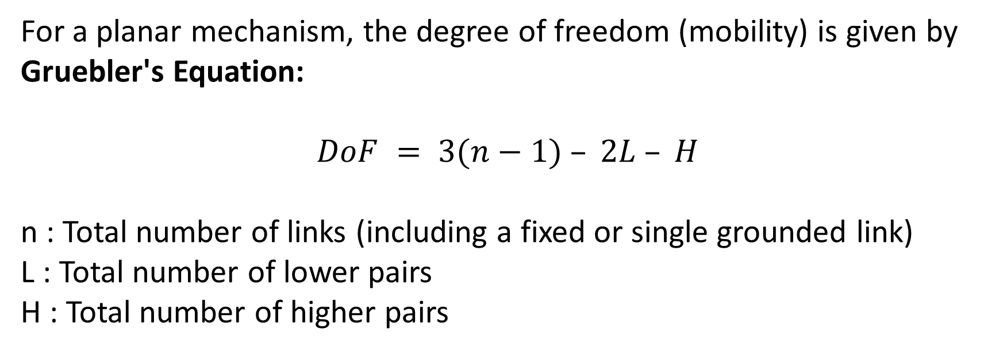
Gruebler's Equation
For a planar mechanism, the degree of freedom (mobility) is given by Gruebler's Equation:
$DoF = 3(n−1) – 2L – H$
n : Total number of links (including a fixed or single grounded link)
L : Total number of lower pairs
H : Total number of higher pairs

Slide 10
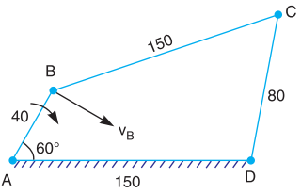
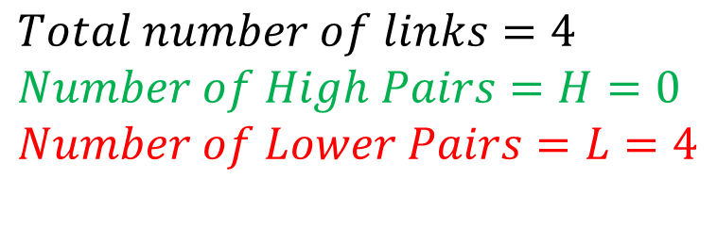
Question
$DoF = 3(n−1) – 2L – H$
$DoF = 3(4−1) – 2×4 –0$
3
$DoF =1$
2
4
1
$$Total number of links=4 \\ Number of High Pairs=H=0 \\ Number of Lower Pairs=L=4$$

Slide 11
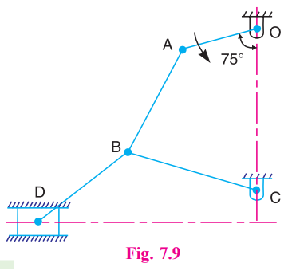
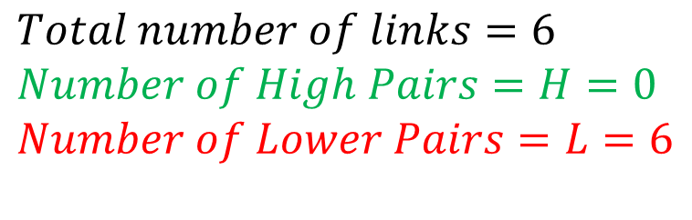

2
$DoF = 3(n−1) – 2L – H$
1
$$Multiple Joint$$
3 links, 2 pairs
$DoF = 3(6−1) – 2×6 –0$
3
$DoF =3$
5
4
1
6
$$Total number of links=6 \\ Number of High Pairs=H=0 \\ Number of Lower Pairs=L=6$$

Slide 12
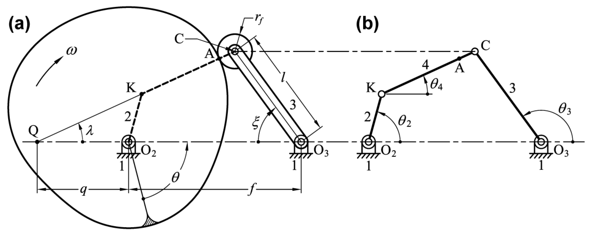
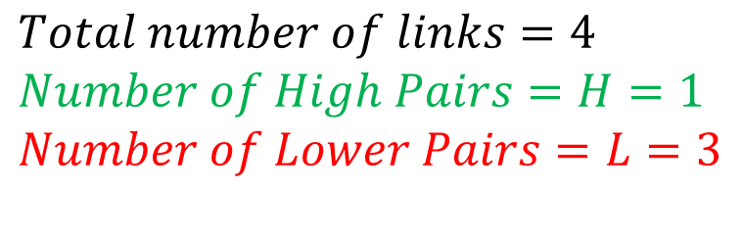
3
$DoF = 3(n−1) – 2L – H$
4
2
$DoF = 3(4−1) – 2×3 –1$
1
$DoF =2$
1
$$Total number of links=4 \\ Number of High Pairs=H=1 \\ Number of Lower Pairs=L=3$$

Slide 13
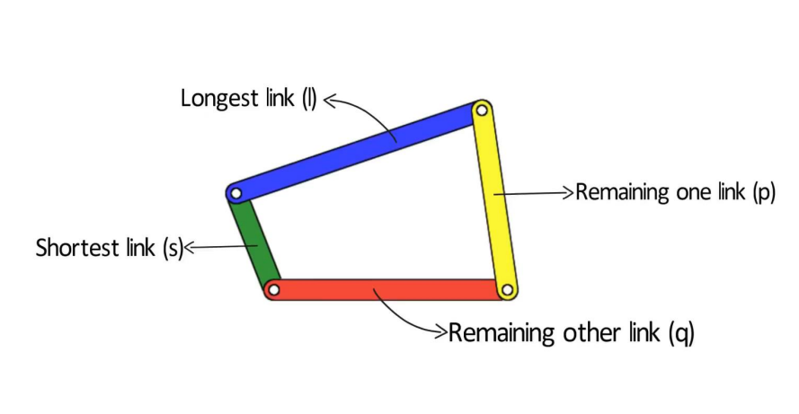
Simple mechanisms
The simplest linkage that allows relative motion is called a four bar linkage.

Slide 14

Double Crank Mechanism

Slide 15

Crank Rocker Mechanism

Slide 16
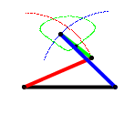
Double rocker mechanism

Slide 17
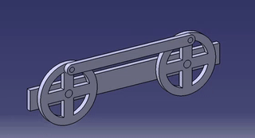
Locomotive Mechanism

Slide 18
Velocity Vector Diagram
Section 2

Slide 19

01. In a four bar chain ABCD, AD is fixed and is 150 mm long. The crank AB is 40 mm long and rotates at 120 r.p.m. clockwise, while the link CD = 80 mm oscillates about D. BC and AD are of equal length. Find the angular velocity of link CD when angle BAD = 60°

Slide 20
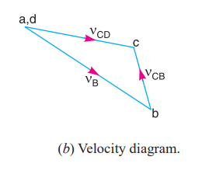
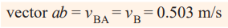
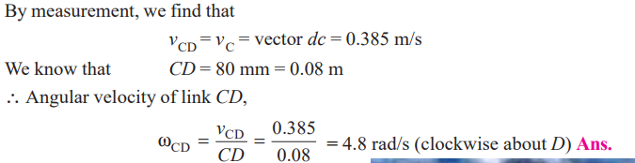

Slide 21
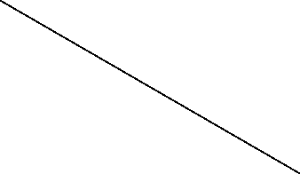
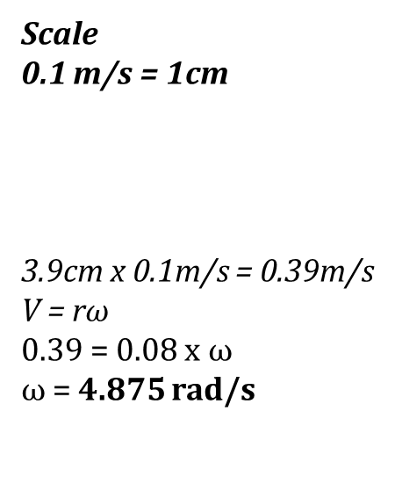
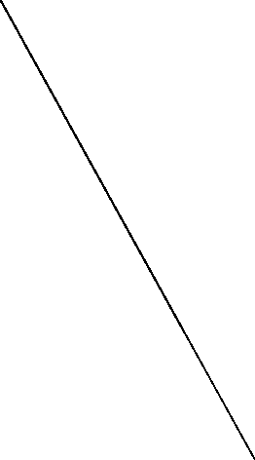
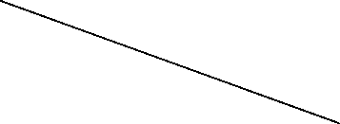
v_{C}
v_{CB}
A,D
Scale
0.1 m/s = 1cm
3.9cm x 0.1m/s = 0.39m/s
V = r$ω$
0.39 = 0.08 x $ω$
$ω$ = 4.875 rad/s
C
B

Slide 22
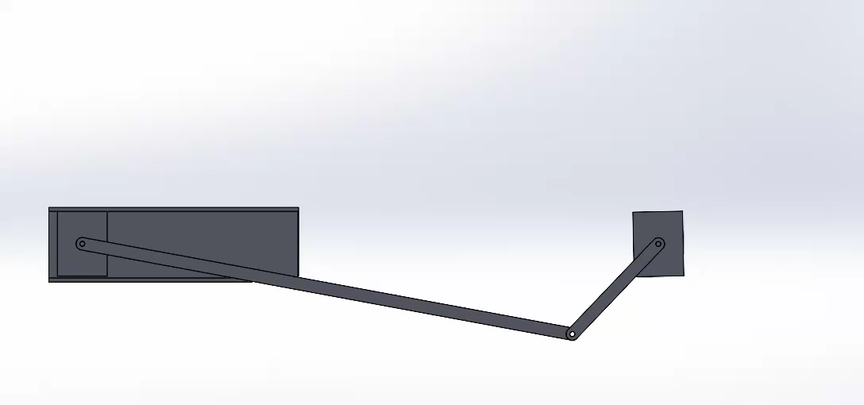
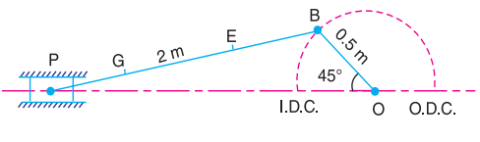
02. The crank and connecting rod of a theoretical steam engine are 0.5 m and 2 m long respectively. The crank makes 180 r.p.m. in the clockwise direction. When it has turned 45° from the inner dead centre position, determine : 1. velocity of piston, 2. angular velocity of connecting rod, 3. velocity of point E on the connecting rod 1.5 m from the gudgeon pin, 4. velocities of rubbing at the pins of the crank shaft, crank and crosshead when the diameters of their pins are 50 mm, 60 mm and 30 mm respectively, 5. position and linear velocity of any point G on the connecting rod which has the least velocity relative to crank shaft.

Slide 23
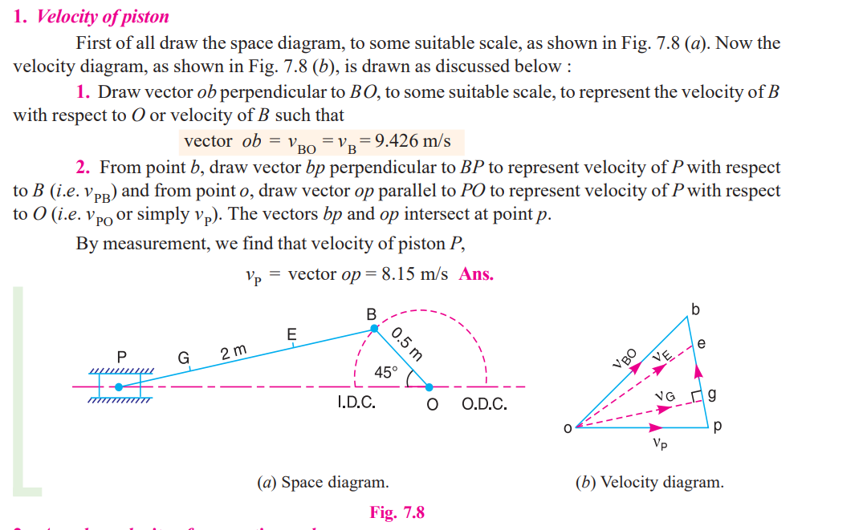

Slide 24
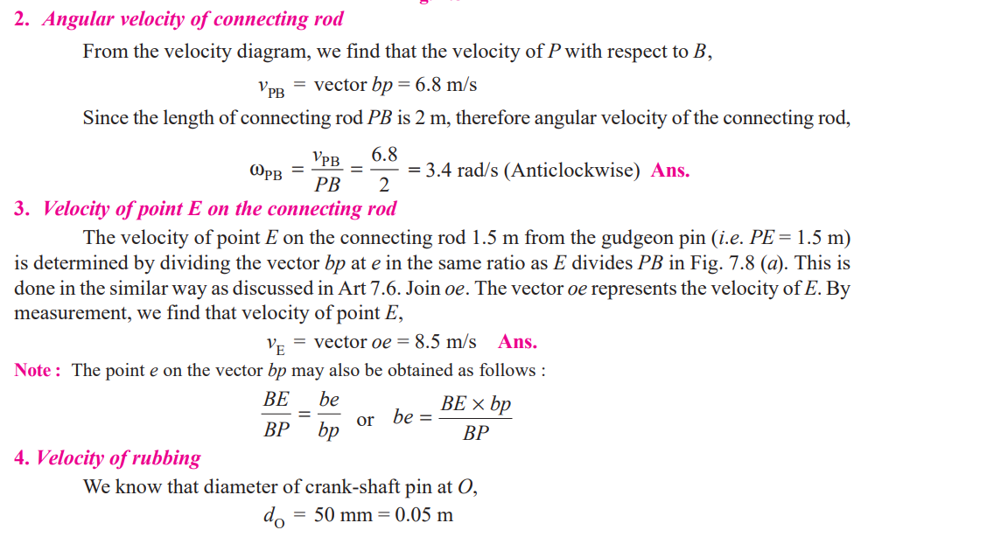

Slide 25
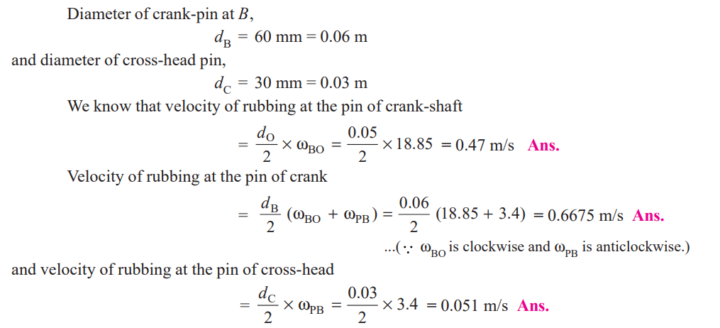

Slide 26
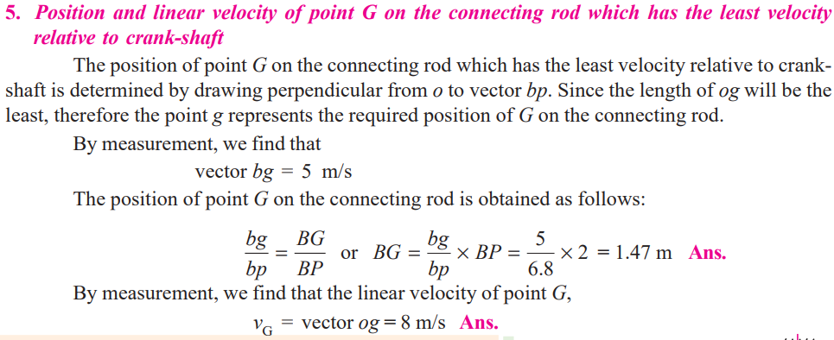

Slide 27
03. In Figure, the angular velocity of the crank OA is 600 r.p.m. Determine the linear velocity of the slider D and the angular velocity of the link BD, when the crank is inclined at an angle of 75° to the vertical. The dimensions of various links are : OA = 28 mm ; AB = 44 mm ; BC 49 mm ; and BD = 46 mm. The center distance between the centers of rotation O and C is 65 mm. The path of travel of the slider is 11 mm below the fixed point C. The slider moves along a horizontal path and OC is vertical.

Slide 28
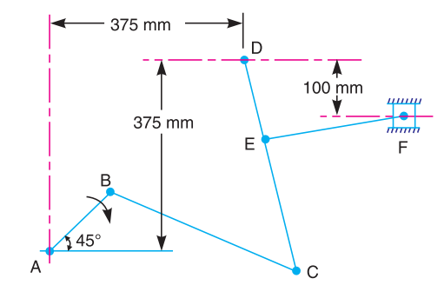
04. The mechanism, as shown in Figure, has the dimensions of various links as follows :
AB = DE = 150 mm ; BC = CD = 450 mm ; EF = 375 mm. The crank AB makes an angle of 45° with the horizontal and rotates about A in the clockwise direction at a uniform speed of 120 r.p.m. The lever DC oscillates about the fixed point D, which is connected to AB by the coupler BC. The block F moves in the horizontal guides, being driven by the link EF. Determine: 1. velocity of the block F, 2. angular velocity of DC, and 3. rubbing speed at the pin C which is 50 mm in diameter.

Slide 29
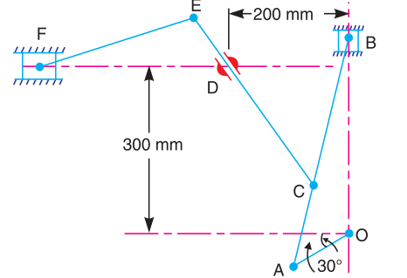
05. In a mechanism shown in Figure, the crank OA is 100 mm long and rotates clockwise about O at 120 r.p.m. The connecting rod AB is 400 mm long. At a point C on AB, 150 mm from A, the rod CE 350 mm long is attached. This rod CE slides in a slot in a trunnion at D. The end E is connected by a link EF, 300 mm long to the horizontally moving slider F. For the mechanism in the position shown, find 1. velocity of F, 2. velocity of sliding of CE in the trunnion, and 3. angular velocity of CE.

Slide 30
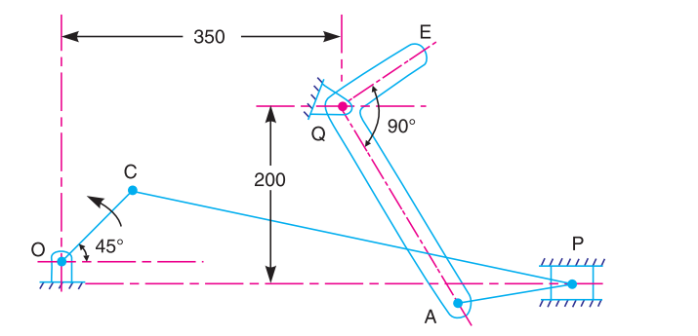
06. In a mechanism as shown in Figure, the various dimensions are : OC = 125 mm ; CP = 500 mm ; PA = 125 mm ; AQ = 250 mm and QE = 125 mm. The slider P translates along an axis which is 25 mm vertically below point O. The crank OC rotates uniformly at 120 r.p.m. in the anti-clockwise direction. The bell crank lever AQE rocks about fixed centre Q. Draw the velocity diagram and calculate the absolute velocity of point E of the lever.

Slide 31
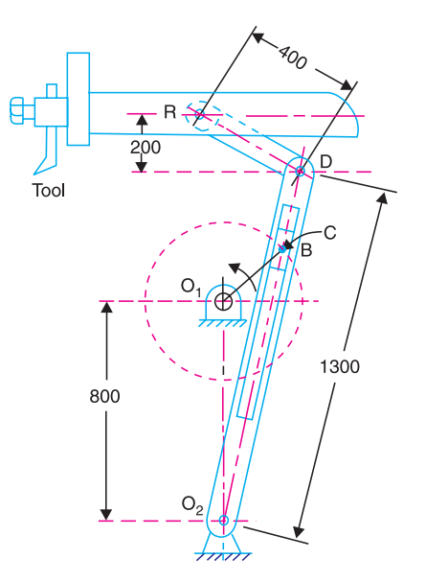
07. A quick return mechanism of the crank and slotted lever type shaping machine is shown in Fig. The dimensions of the various links are as follows : O₁O₂ = 800 mm ; O₁ B = 300 mm ; O₂D = 1300 mm ; DR = 400 mm. The crank O₁B makes an angle of 45° with the vertical and rotates at 40 r.p.m. in the counter clockwise direction. Find : 1. velocity of the ram R, or the velocity of the cutting tool, and 2. angular velocity of link O₂ D.

Slide 32
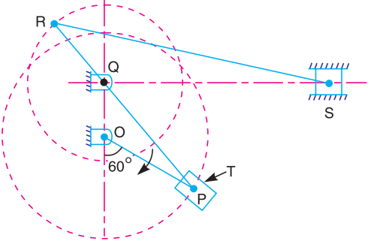
08. Figure shows the structure of Whitworth quick return mechanism used in reciprocating machine tools. The various dimensions of the tool are as follows : OQ = 100 mm ; OP = 200 mm, RQ = 150 mm and RS = 500 mm. The crank OP makes an angle of 60° with the vertical. Determine the velocity of the slider S (cutting tool) when the crank rotates at 120 r.p.m. clockwise. Find also the angular velocity of the link RS and the velocity of the sliding block T on the slotted lever QT.

Slide 33
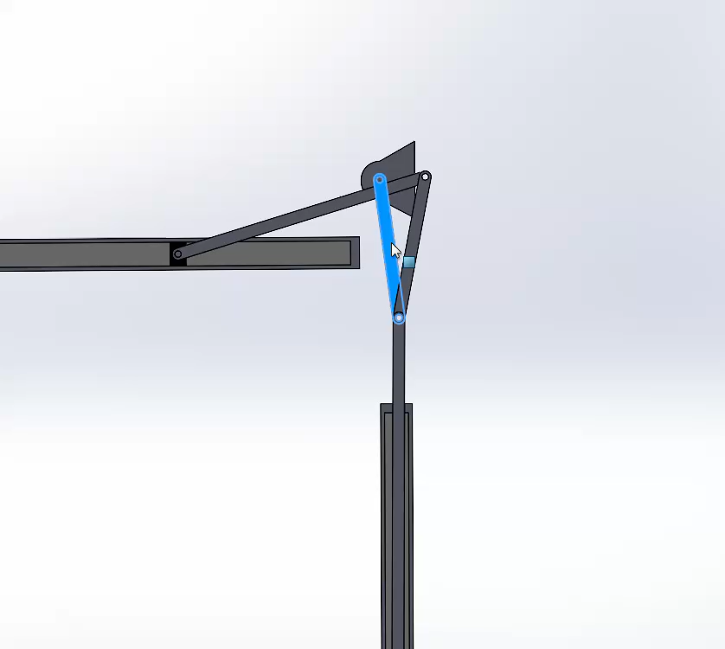
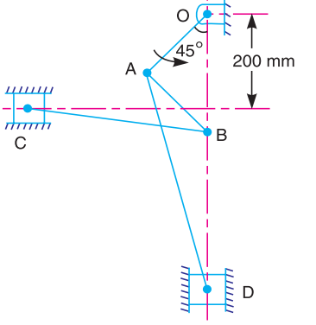
09. The dimensions of the various links of a pneumatic riveter, as shown in Figure, are as follows : OA = 175 mm ; AB = 180 mm ; AD = 500 mm ; and BC = 325 mm. Find the velocity ratio between C and ram D when OB is vertical when OA crank rotates with 100 r.p.m. using velocity vector diagram.

Slide 34
Acceleration Vector Diagram
Section 3

Slide 35
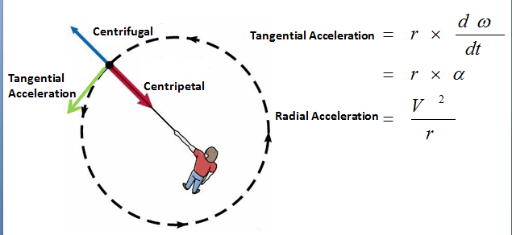
Theory
(centripetal acceleration)

Slide 36
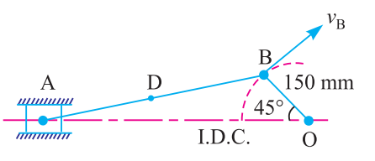
The crank of a slider crank mechanism rotates clockwise at a constant speed of 300 r.p.m. The crank is 150 mm and the connecting rod is 600 mm long. Determine : 1. linear velocity and acceleration of the midpoint of the connecting rod, and 2. angular velocity and angular acceleration of the connecting rod, at a crank angle of 45° from inner dead centre position.

Slide 37
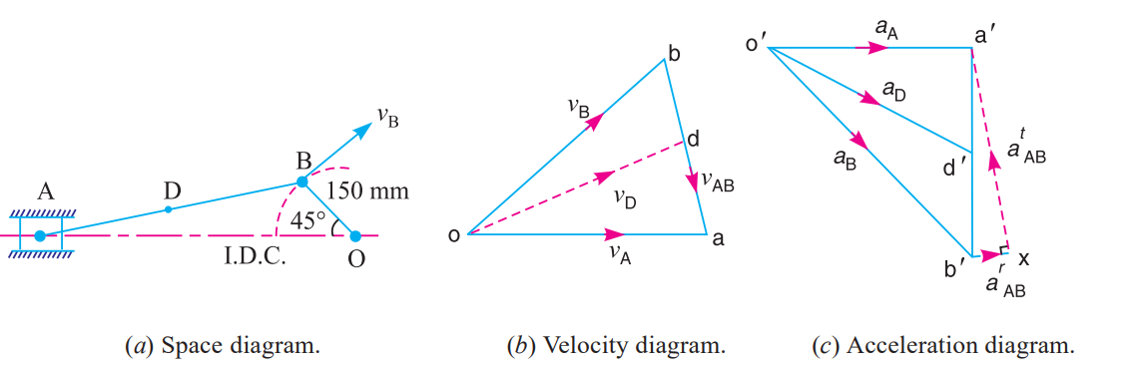

Slide 38
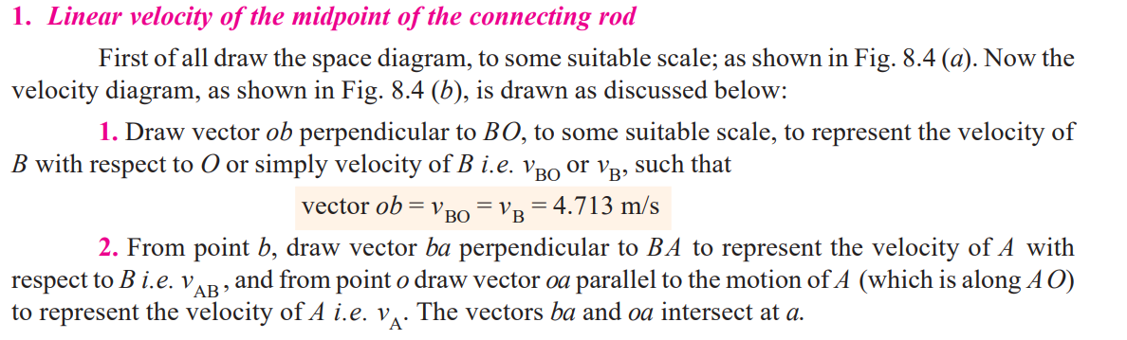
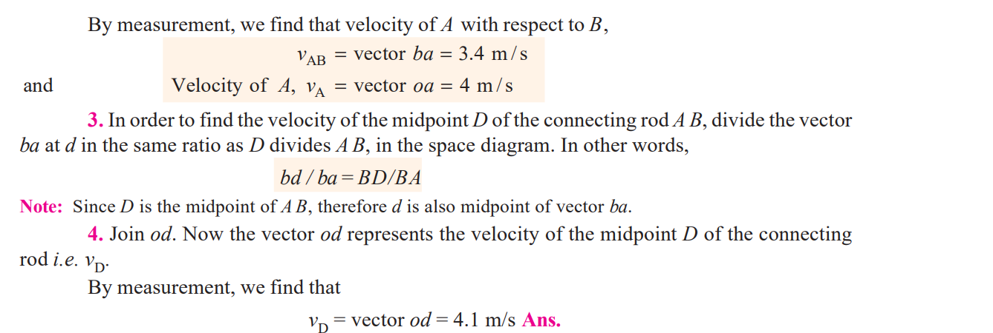

Slide 39
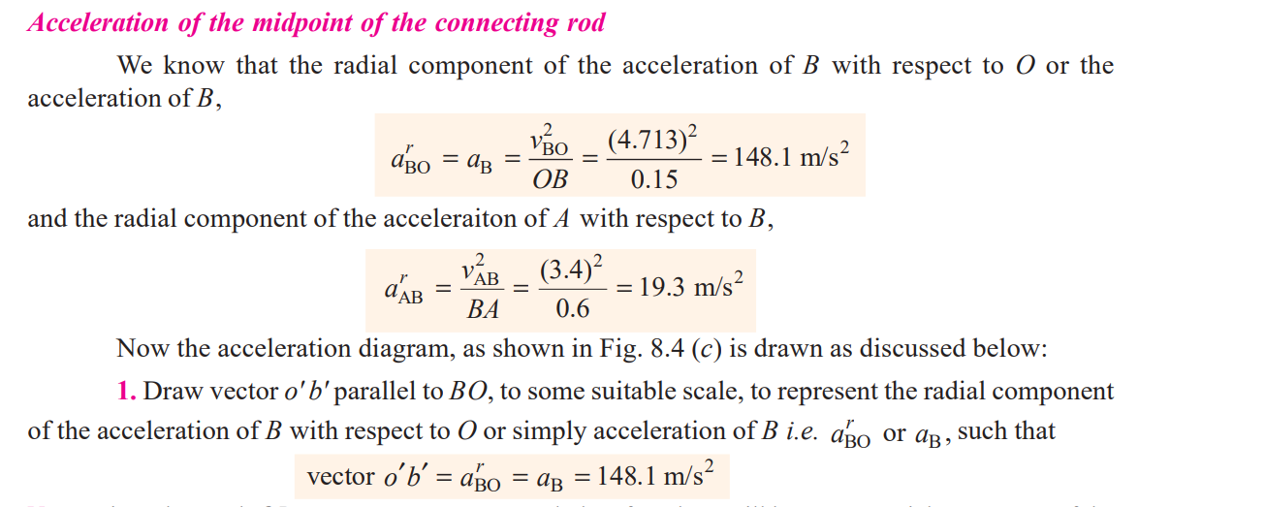

Slide 40
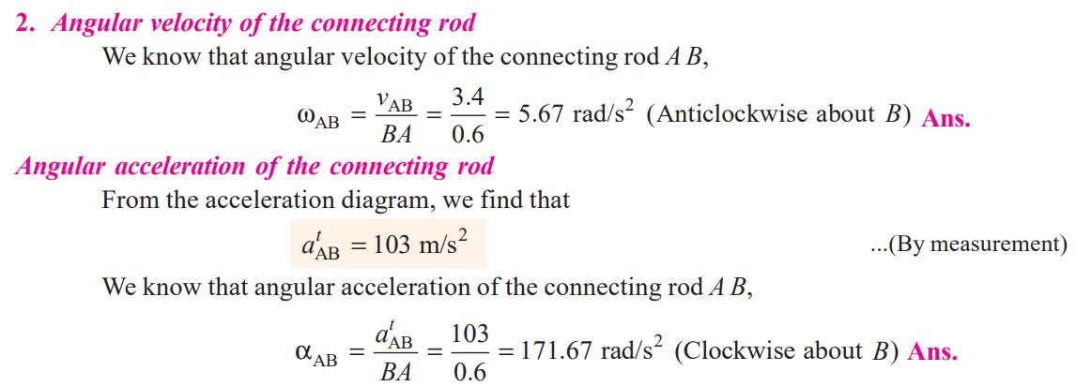

Slide 41
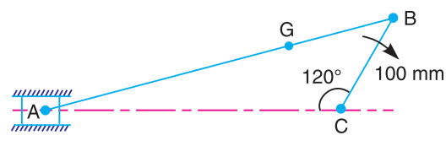
An engine mechanism is shown in Fig. 8.5. The crank CB = 100 mm and the connecting rod BA = 300 mm with centre of gravity G, 100 mm from B. In the position shown, the crankshaft has a speed of 75 rad/s and an angular acceleration of 1200 rad/s2. Find:1. velocity of G and angular velocity of AB, and 2. acceleration of G and angular acceleration of AB.

Slide 42
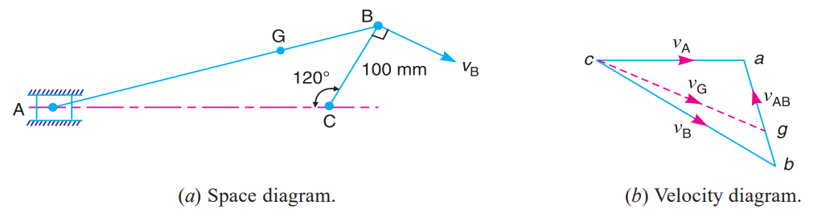
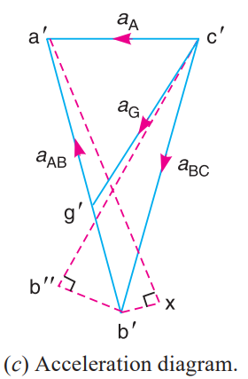

Slide 43
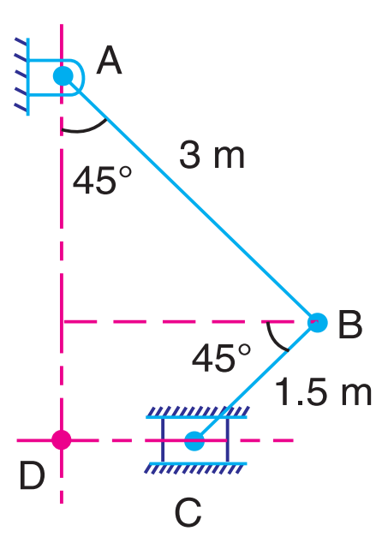
In the mechanism shown in Fig. 8.7, the slider C is moving to the right with a velocity of 1 m/s and an acceleration of 2.5 m/s2. The dimensions of various links are AB = 3 m inclined at 45° with the vertical and BC = 1.5 m inclined at 45° with the horizontal. Determine: 1. the magnitude of vertical and horizontal component of the acceleration of the point B, and 2. the angular acceleration of the links AB and BC.

Slide 44
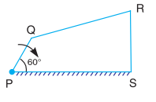
PQRS is a four bar chain with link PS fixed. The lengths of the links are PQ = 62.5 mm ; QR = 175 mm ; RS = 112.5 mm ; and PS = 200 mm. The crank PQ rotates at 10 rad/s clockwise. Draw the velocity and acceleration diagram when angle QPS = 60° and Q and R lie on the same side of PS. Find the angular velocity and angular acceleration of links QR and RS.

Slide 45
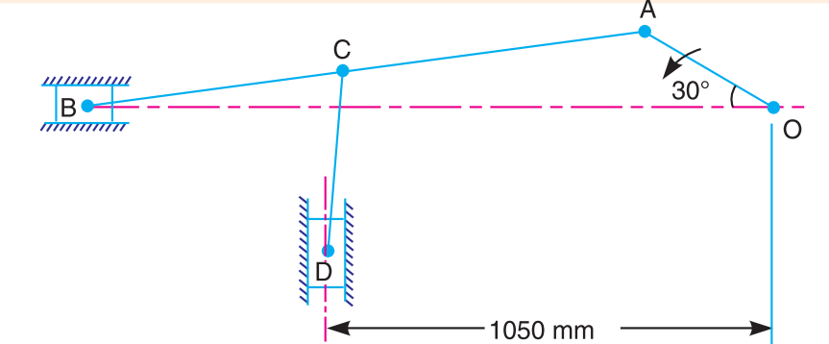
In the mechanism, as shown in Fig. 8.12, the crank OA rotates at 20 r.p.m. anticlockwise and gives motion to the sliding blocks B and D. The dimensions of the various links are OA = 300 mm; AB = 1200 mm; BC = 450 mm and CD = 450 mm. For the given configuration, determine : 1. velocities of sliding at B and D, 2. angular velocity of CD, 3. linear acceleration of D, and 4. angular acceleration of CD.

Slide 46
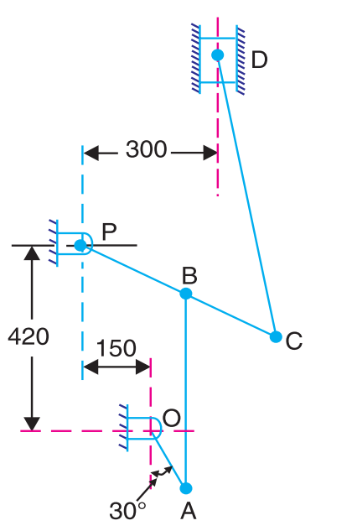
Find out the acceleration of the slider D and the angular acceleration of link CD for the engine mechanism shown in Fig. 8.14. The crank OA rotates uniformly at 180 r.p.m. in clockwise direction. The various lengths are: OA = 150 mm ; AB = 450 mm; PB = 240 mm ; BC = 210 mm ; CD = 660 mm.

Slide 47
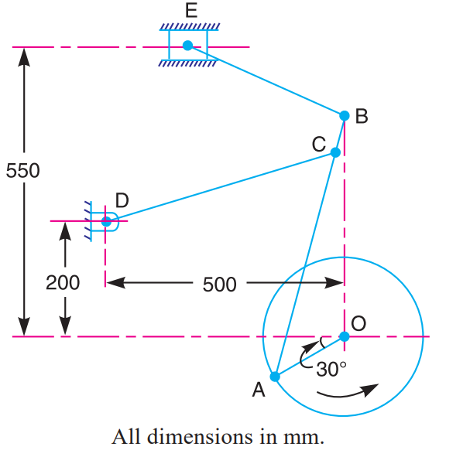
Fig. 8.22 shows the mechanism of a radial valve gear. The crank OA turns uniformly at 150 r.p.m and is pinned at A to rod AB. The point C in the rod is guided in the circular path with D as centre and DC as radius. The dimensions of various links are: OA = 150 mm ; AB = 550 mm ; AC = 450 mm ; DC = 500 mm ; BE = 350 mm. Determine velocity and acceleration of the ram E for the given position of the mechanism.

Slide 48

In a Whitworth quick return motion, as shown in Fig. 8.32. OA is a crank rotating at 30 r.p.m. in a clockwise direction. The dimensions of various links are : OA = 150 mm; OC = 100 mm; CD = 125 mm; and DR = 500 mm. Determine the acceleration of the sliding block R and the angular acceleration of the slotted lever CA.

Slide 49

In a mechanism as shown in Fig. 8.40, the crank OA is 100 mm long and rotates in a clockwise direction at a speed of 100 r.p.m. The straight rod BCD rocks on a fixed point at C. The links BC and CD are each 200 mm long and the link A B is 300 mm long. The slider E, which is driven by the rod DE is 250 mm long. Find the velocity and acceleration of E.
[Ans. 1.26 m/s; 10.5 m/s²]

Slide 50
Reference Theory of Machines by Khurmi

